Slide 1

Engineering Research Skills
Researching literature and using online resources
Victoria Hopton Lewis Coyne
Subject Librarian Teaching and Learning Librarian
victoria.hopton@bristol.ac.uk lewis.coyne@bristol.ac.uk

Slide 2
In this session
Why review literature?
Locating resources
Search techniques
Have a go!
Academic language
Referencing and avoiding plagiarism
Q&A
Further help

Slide 3
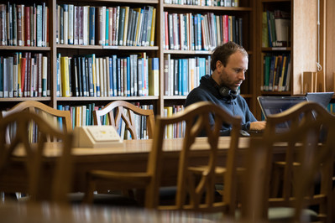
“Ever since Sir Isaac Newton's times, scientists have worked in the same sort of way:
They show a great respect for experiment and observation, they don't cherry pick data, they take a sceptical approach to what they do.
And then scientists work together to get a consensus as to what should be believed.
And that generates very reliable knowledge and that reliable knowledge drives innovation. ”
Paul Nurse, Chancellor of the University of Bristol Newsnight, 30th March 2011

Slide 4
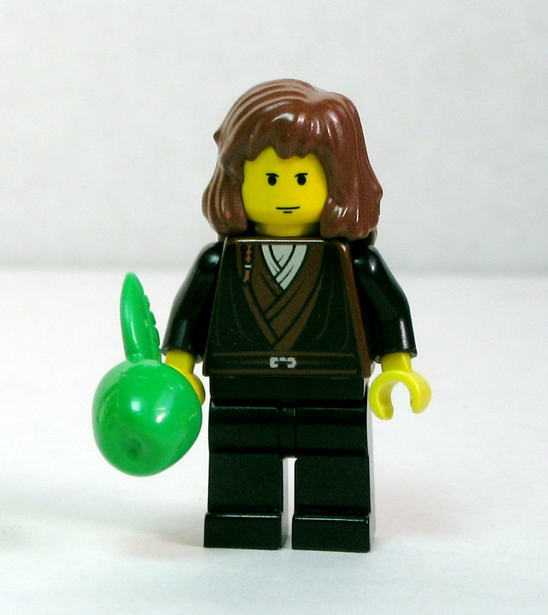
“If I have seen further than others, it is by standing upon the shoulders of giants.”​ ​
Science defies common sense – it needs testing​
Extraordinary claims need extraordinary evidence​
Science builds on the work of others​
Science is uncertain​
Science and consensus

Slide 5
Why review?
To make sure you are not re-inventing the wheel.​
Allows you to demonstrate how your work is situated within, builds upon, and departs from earlier publications.​
It shows that you are a member of your chosen field.​
A researcher should have previous knowledge of previous work on a topic before undertaking any investigation. ​
Past studies can contribute to the improvement of new studies.

Slide 6
We have...
45,000 metres of stock
Over 700,000 ebooks
1000s of ejournals
100s of databases
But also...
Standards
Patents
Dissertations/Theses
Open Access material
Useful websites

Slide 7
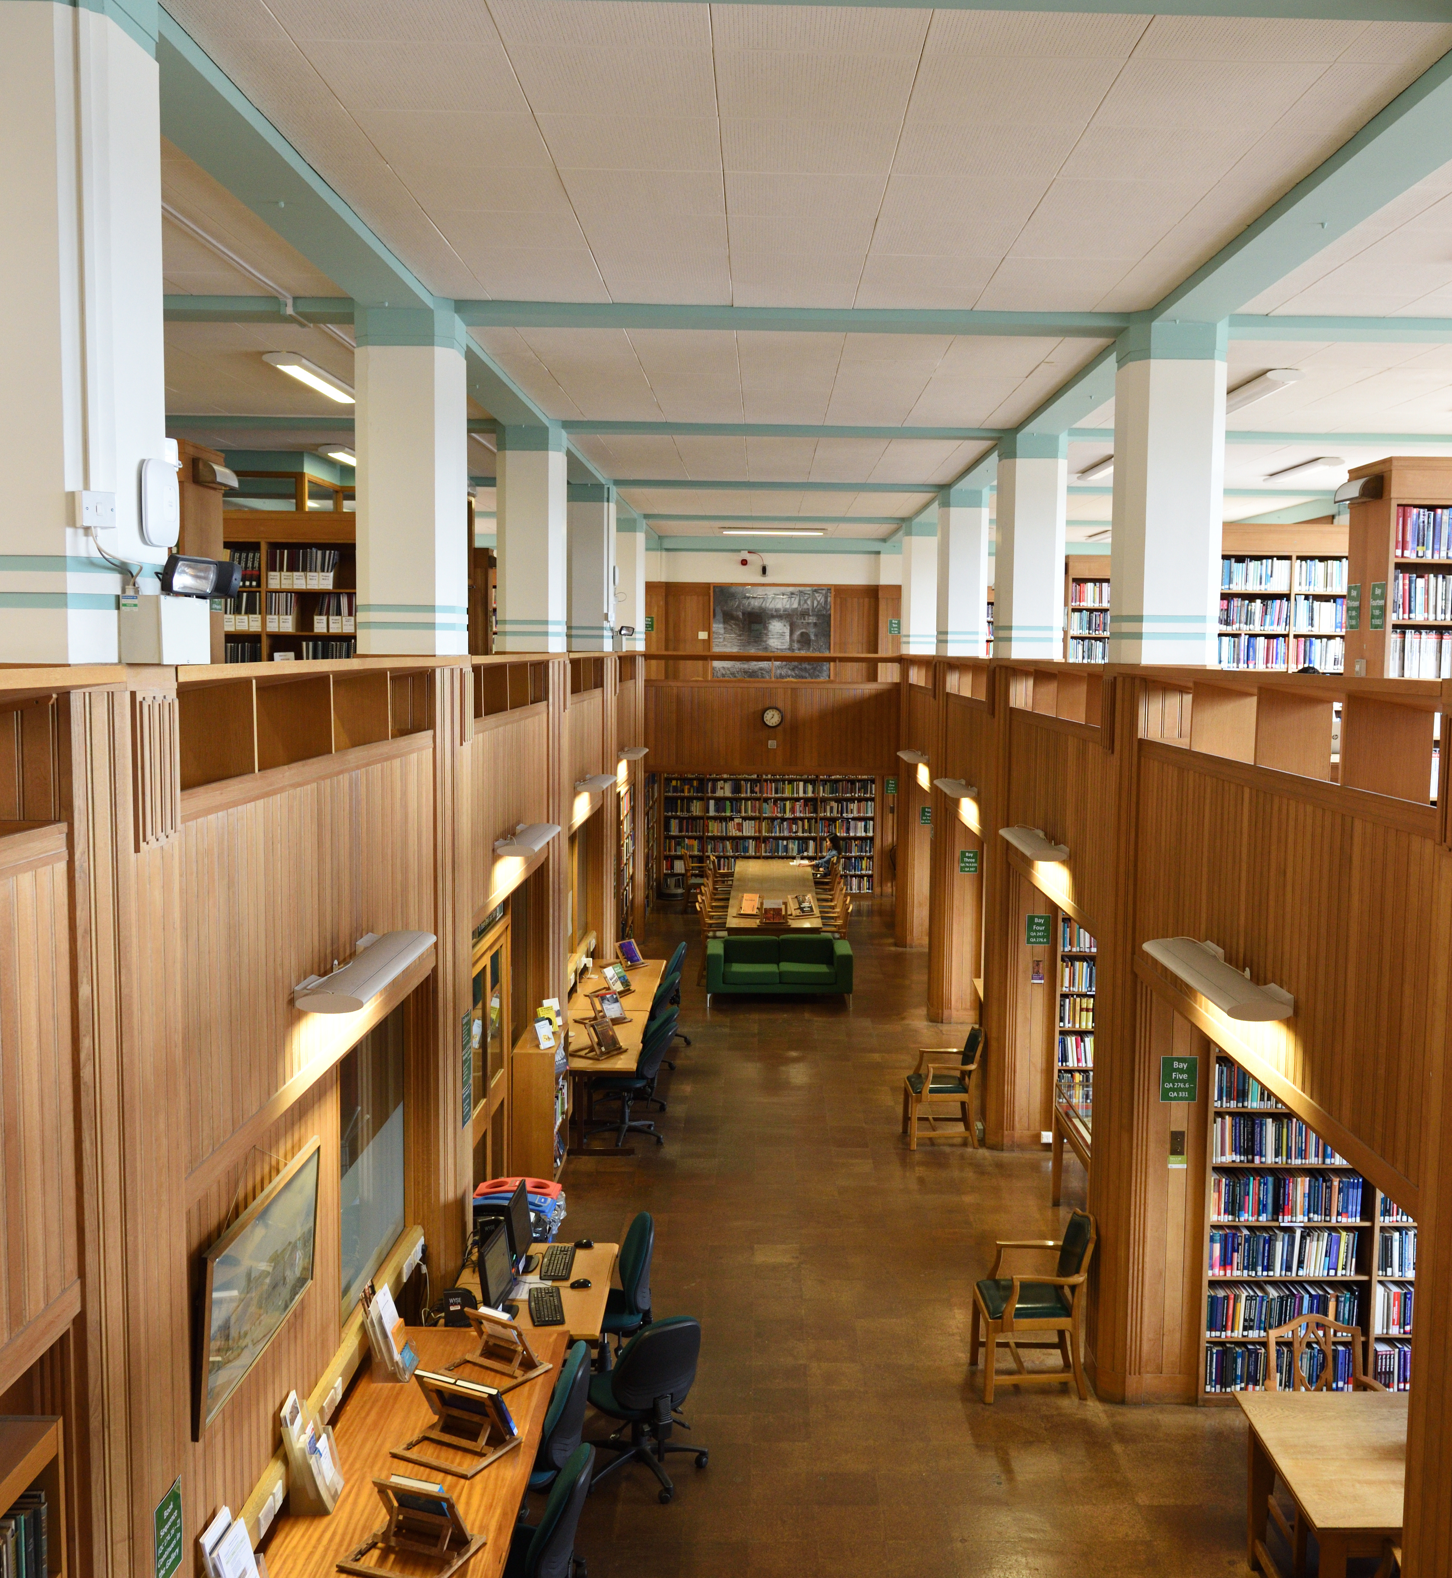
UG & PGT: 40 items
self-service
automatic renewals
reserve/request items
off-site research reserve
Inter-library loans
no late fees
8 UoB Libraries + study spaces
live chat service
Subject Librarian team

Slide 8
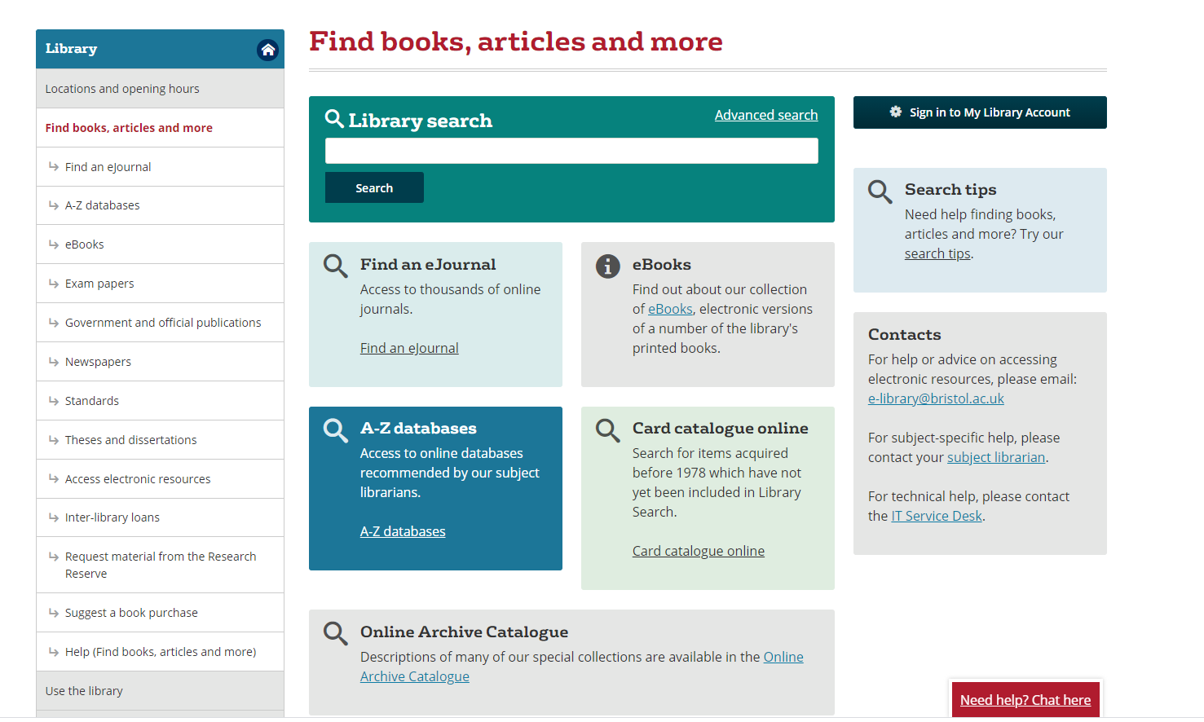

Slide 9
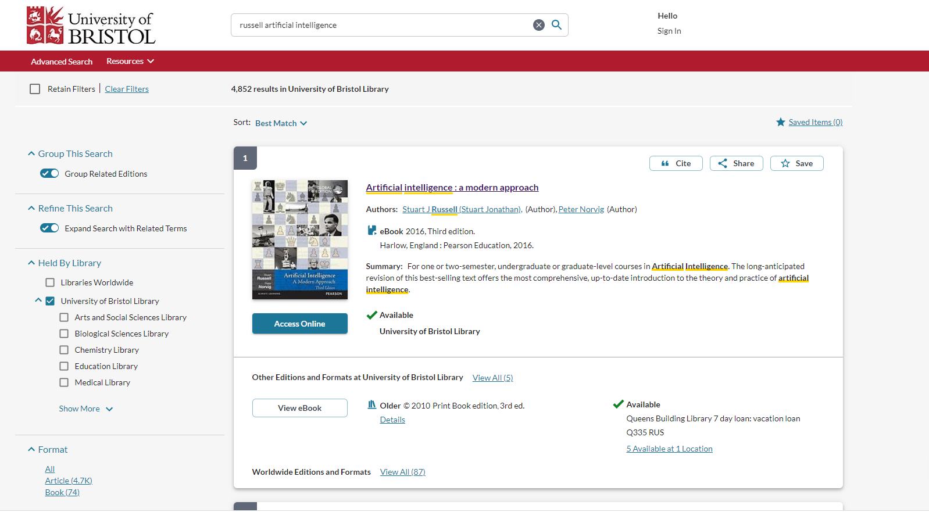

Slide 10





Journals

Slide 11






Databases

Slide 12

Library subject guides
For help with:
Finding information
Recommended resources
Referencing
Academic writing
Book an appointment

Slide 13
Why use
Library
Databases
Coverage (Human vs machine curated)
Authority
Number of hits (quantity ≠ quality)
Relevance (subject focus)
Search features and added functions
Free access to Published/’paid for’ materials

Slide 14
Other sources
Reports
Discussion papers/Working papers
Theses and dissertations
Newsletters
Market reports
Govt. documents
Statistical sources
Standards and patents

Slide 15
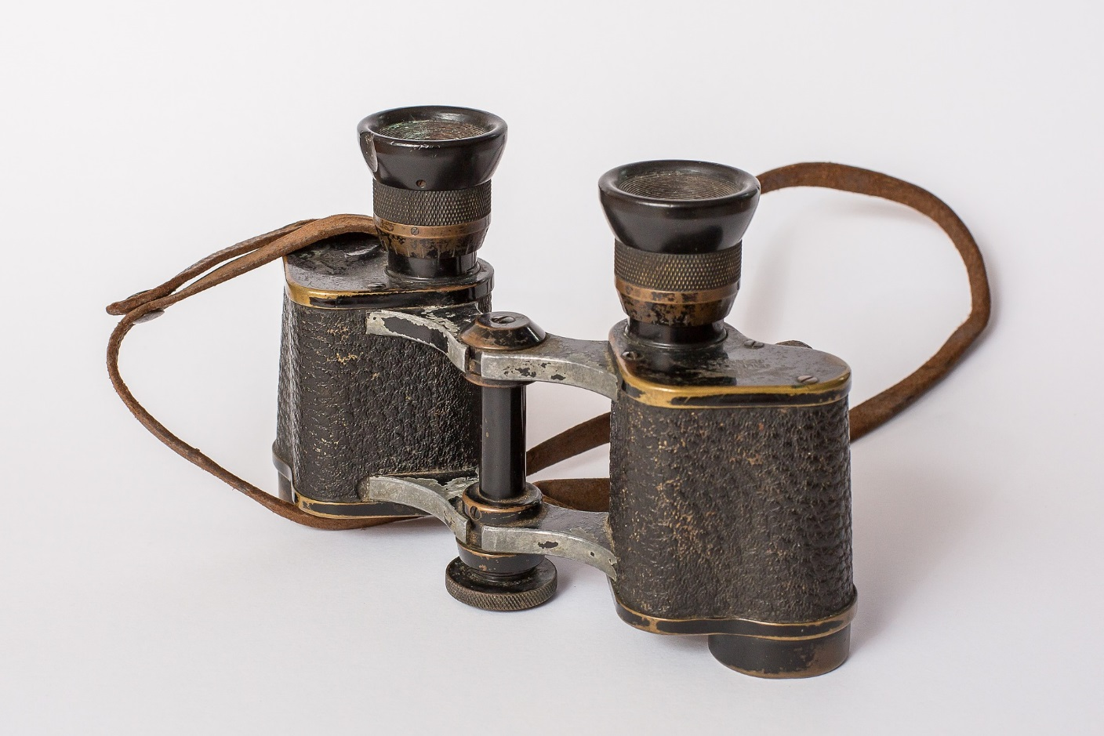

Google Scholar
Google Scholar is useful for obtaining a broad picture.
Fast, user friendly, familiar
Good for grey literature
Useful results, good starting point
However there are some key limitations
Not all scholarly content, not peer-reviewed
Can easily miss important research
Advanced searching is limited

Slide 16
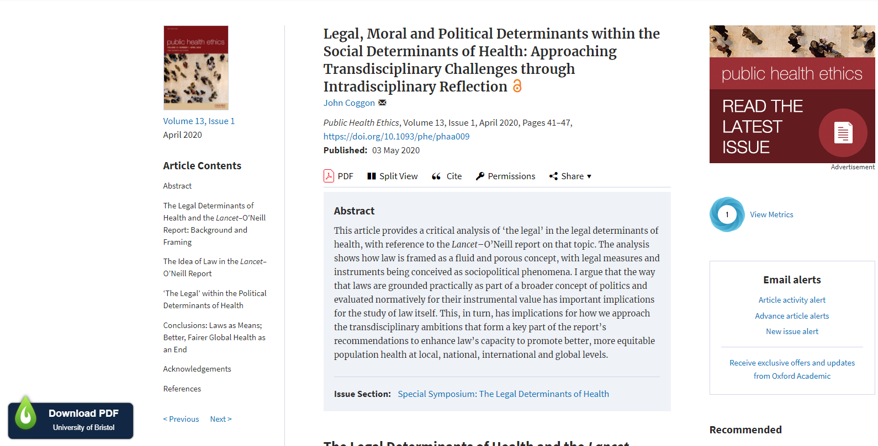
LibKey Nomad

Slide 17
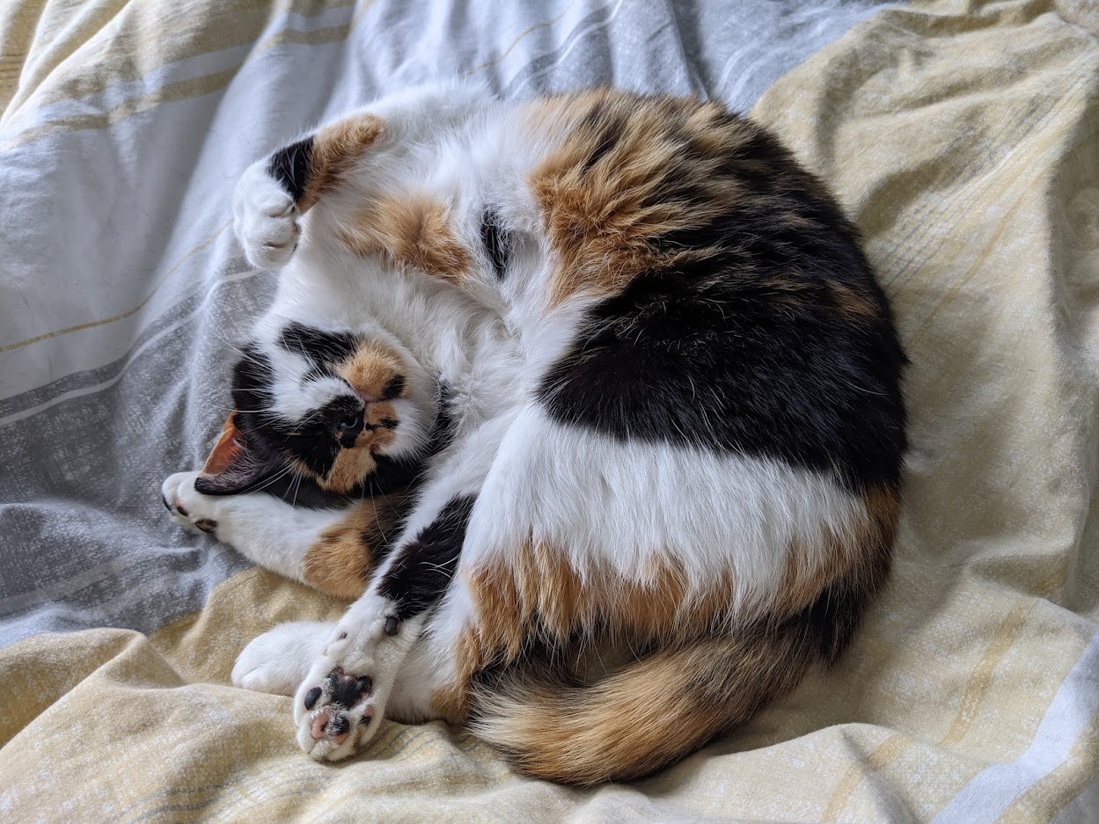
Have a go! (5 minutes)
Write down as many keywords (search terms) as you can, to describe your area of research.
e.g. Calico cats in folklore
calico, tortoiseshell, tri-colour
mythology, folklore, history, superstition

Slide 18

Combining terms with operators
OR
OR
AND – narrows a search by finding results that only contain multiple terms
OR
OR – broadens a search by finding results that contain any single term
OR
OR

Slide 20
Tips and tricks
NB – these tips vary between databases. Check the Help menu of a database if you’re uncertain
Phrase searching
“social media”
looks for the exact phrase social media
Wildcards – usually a ?
organi?ation
finds organisation and organization
Truncation – usually a * symbol
teen*
finds all words beginning teen…
Proximity – NEAR/x or similar
portray* NEAR/3 poverty
finds incidents where the term portray* appears within 3 words of the term poverty

Slide 21
So a combined search might look like this…
autonomous vehicles
OR
self-driving cars
OR
driverless cars
harm*
OR
risk*
OR
danger*
ethic*
OR
moral*
AND
AND

Slide 22
Reviewing and evaluating
Read the abstract – is it relevant? – Coverage​
Is it free of errors backed up by reliable sources? - Accuracy​
Who wrote it? Expert? Academic? Corporation? - Authority​
​
Bias? Commercial interest? - Objectivity​
​When was it published? - Currency

Slide 23
Be sceptical
“The first principle is that you must not fool yourself and you are the easiest person to fool.”​
​
“It is of great value to realise that we do not know the answers to different questions. This attitude of mind - this attitude of uncertainty - is vital to the scientist, and it is this attitude of mind which the student must first acquire.”
(Richard Feynman)

Slide 24
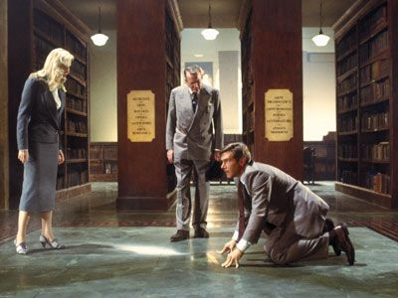
Have a go! (20 minutes)
Use your keywords to explore some resources e.g.
Library Search
Browzine
Databases
Google scholar

Slide 25
Activity feedback…
Which resource have you found useful and will look at again in your research?

Slide 26
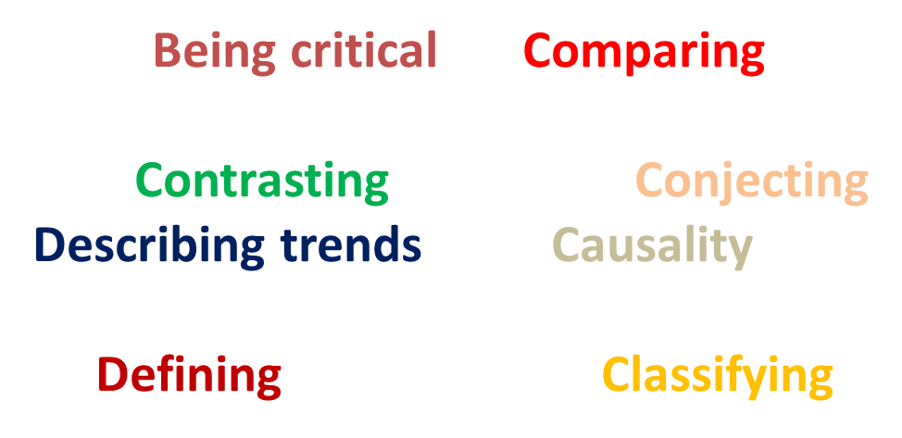
Academic language
Academic phrasebank: phrasebank.manchester.ac.uk/
Notes:
The Academic Phrasebank is a general resource for academic writers. It aims to provide you with examples of some of the phraseological ‘nuts and bolts’ of writing organised according to the main sections of a research paper or dissertation.
The phrases, and the headings under which they are listed, can be used simply to assist you in thinking about the content and organisation of your own writing, or the phrases can be incorporated into your writing where this is appropriate

Slide 27
Metadiscourse
Elements of your review that do not add specific content, but are intended to reveal organisation and help readers through your text.​
​
The first part of this review traces the early development of satellite communications.​
The military uses of communication satellites will be taken up in the next section.​
This section examines studies in the use of satellites in global command and control systems.​
​
…build up a relationship with your reader, engage them.

Slide 28
Referencing & plagiarism

Slide 29

Plagiarism (and how to avoid it)
Q. What is plagiarism?
Plagiarism is the representation of previous work as your present work.
It can be deliberate or unintentional
Plagiarism (n.d.) Available at: https://www.ox.ac.uk/students/academic/guidance/skills/plagiarism [accessed 15 November 2021].

Slide 30
Common causes of plagiarism
Most cases of plagiarism are unintentional – they usually result from not knowing:
Why to reference
When to reference
or
How to reference

Slide 31

When should I cite?
Always provide a reference for information or ideas (except general/common knowledge) that you encountered in someone’s work
This includes data, graphs, images, and more – not just written words!

Slide 32
General & common knowledge
Facts expected to be known by any competent adult member of the public
Facts likely to be known by someone studying or working in a particular field
This is general knowledge. An example might be: ‘Boris Johnson is the current Prime Minister of the United Kingdom’.
This is common knowledge. An example (for Law) might be: ‘England and Wales share a common law legal system, while Scotland has a mixed legal system’.

Slide 33

Three ways of using sources
In an essay you’ll likely use sources in three different ways: quoting, paraphrasing, and summarising
It’s important to understand the difference between them, and different reference requirements of each

Slide 34
Which is which?
1. According to Simone de Beauvoir ‘[o]ne is not born, but rather becomes a woman’ (1997: 295), by which she meant…
2. Certain authors have argued that womanhood is the result of female socialisation (e.g. de Beauvoir, 1997), while other writers are of the opinion that…
3. Simone de Beauvoir famously claimed that females are not born as women, but instead become them through the process of socialisation (1997).
This is a quote! Be sure to give the page number
This is summarising: giving a passing mention
This is paraphrasing: more depth, but still your own words

Slide 35
Cite Them Right
An online resource that provides detailed guidance on the layout of citations and bibliographies
Includes a large range of resource formats and referencing styles
https://www.citethemrightonline.com/

Slide 36

EndNote
EndNote is a reference management software that allows you to store PDFs, quickly cite, and create a bibliography
Alternatives include Zotero and Mendeley
OR
OR
OR
You can get both the desktop and online versions of EndNote through the Library: https://www.bristol.ac.uk/library/subject-support/referencing/endnote/
OR

Slide 37
OR
OR
OR

Slide 38
EndNote
The Library has a tutorial and quick guide to using both the online and desktop versions
OR
Go to: http://www.bris.ac.uk/library/subject-support/referencing/endnote/

Slide 39
EndNote
The Library also offers regular training sessions on both the desktop and online versions of EndNote
OR
Go to: http://www.bristol.ac.uk/library/events/

Slide 40
Can't find what you need?
Suggest a book purchase
http://bristol.ac.uk/library/find/suggest-purchase/
Inter-library loans
http://bristol.ac.uk/library/find/inter-loans/
Library Search - 'libraries worldwide'

Slide 41
For further help and support...
Victoria Hopton
Subject Librarian
Victoria.hopton@bristol.ac.uk
bristol.ac.uk/library/subject-support/

